Slide 1
Asynchronous Programming with Twisted

Slide 2
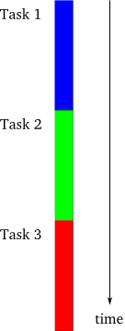
Single Threaded Synchronous Model
Doing things one at a time, in order.
Simple to think about and plan.
Later tasks can assume an earlier task finished.

Slide 3
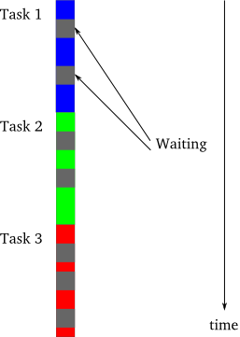
What’s wrong with Synchronous?
The synchronous model is nice and simple so why do anything else?
If the tasks are non blocking and each task depends on the previous task then synchronous is best
If tasks are largely independent and can be done out of order than synchronous is terrible.
Tasks that must wait on IO / network / a human being will waste a *lot* of cpu cycles and running time!

Slide 4
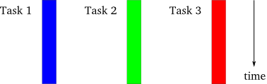
Multi Threaded / Process Model
Doing tasks in parallel.
Threads cannot guarantee another task has finished
More complex to organise
Communications between threads can be nasty!
Risk of thread / process lock / deadlocks and a lot of time spent doing busy *nothing*
OS owns control of thread execution
Threads can be resource intensive depending on your language and architecture.

Slide 5
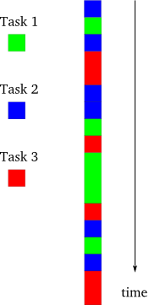
The Asynchronous Model
Interleaving Tasks in the same single Thread / Process
You guarantee that when a task is executing another task is not.
No risk of resource locks / deadlocks on shared resources
Decision to suspend and start tasks is under the programmer’s control.
Cannot make use of multiple CPU’s
Tasks yield control voluntarily.
Not a good fit for high CPU workloads

Slide 6
Multi thread vs Asynchronous Model
Threads have overheads!
Threads are under OS control
Threads can block each other and contend for the same resources. Asynchronous tasks cannot do this.
Managing state across threads is a PITA
When tasks are dominated by IO wait / blocking then a asynch single threaded model can get amazing results compared to multi-thread

Slide 7
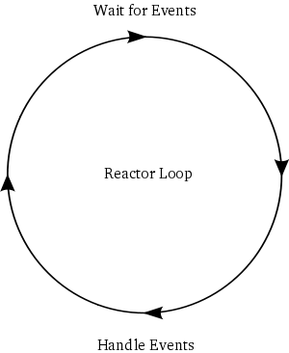
The Reactor / Select loop
A loop that listens and reacts to events
Informs you repeatedly when events are ready
Ideally – abstracts away the underlying horror of networking / socket IO on different systems
Ideally – provides protocols for you to use.
Twisted is a robust cross platform implementation of the reactor pattern with lots of extra stuff thrown in

Slide 8
Python Twisted
Twisted is an event-driven networking engine written in Python and licensed under the open source ​MIT license.
Twisted is very mature with lots of functionality out of the box
Lots of community libraries – database connectors, network clients, etc
The reactor in twisted is a singleton if you import the reactor in a module you will get the same instance as elsewhere in your code.
Twisted calls code using a callback mechanism
Twisted official documentation can be quite challenging to read.
In general: Twisted can be a bit of a brain ****

Slide 9
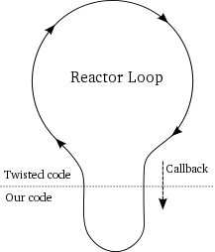
Callbacks in Twisted
Callbacks are triggered by events determined by the programmer
Data ready on a socket for example
The reactor must call our code to handle that event
Callbacks are passed the value from the event as an input – whatever that is.
When our code is running the reactor is not running
Our code must not block!
The reactor loop resumes when our code has finished handling the event

Slide 10
Twisted Callback Example
class Countdown(object): def __init__(self, counter): self.counter = counter def decrement_count(self, decrement): if self.counter < 1: reactor.stop() else: print self.counter self.counter -= decrement reactor.callLater(1, self.decrement_count, decrement) def main(): from twisted.internet import reactor c = Countdown(10) reactor.callWhenRunning(c.decrement_count, 1) print "Reactor Starting..." reactor.run() print "Reactor Stopped!" if __name__ == "__main__": main()
Reactor Starting...
10
9
8
7
6
5
4
3
2
1
Reactor Stopped!

Slide 11
Introducing Deferreds
What do we do if our callback needs to block?
Maybe it needs to make an IO call based on information if got previously?
We can’t do it in our code or that would block the whole reactor!
We’d like to define a chain of connected callbacks that will run, in order, when data becomes available from a previous step.
Twisted calls these deferreds
Think of deferreds as a list or chain of callbacks that will be executed, in order, when the time is right.
Another common name is The Callback Chain
Each callback passes the result of it’s task into the next step of the chain as an input.

Slide 12
Deferred Example
from twisted.internet.defer import Deferred def to_upper(s): return s.upper() def print_foo(foo): print foo return foo def main(): d = Deferred() d.addCallback(print_foo) d.addCallback(to_upper) d.addCallback(print_foo) # fire the chain with a normal result d.callback("yo, uppercase me!") print "Finished" if __name__ == "__main__": main()
yo, uppercase me!
YO, UPPERCASE ME!
Finished

Slide 13
Introducing Errbacks
IF SOMETHING CAN GO WRONG, SOMETHING WILL GO WRONG
So what happens if one our callbacks errors (throws an exception or fails to return a result?)
Callbacks further down the chain will not be called.
Twisted will continue running if we hit an exception and log it.
You probably don’t want a server to die just because you hit an untrapped exception!
The deferred chain will look for an Errback to call with the value returned by the failure
Twisted will pass a Failure instance (think of this as a wrapped exception)
If the ERRBACK returns a result it will be passed to the next CALLBACK in the chain.
If the ERRBACK throws an error (returns a Failure) the next ERRBACK in the chain will be called.

Slide 14
Errback Example
CAUGHT: 'int' object has no attribute 'upper'
from twisted.internet.defer import Deferred def handle_error(error): return "CAUGHT: {e}".format(e = error.getErrorMessage()) def to_upper(s): return s.upper() def print_foo(foo): print foo return foo def main(): d = Deferred() # Add a callback and an errback to fire if something went wrong d.addCallback(to_upper) d.addErrback(handle_error) d.addCallback(print_foo) # fire the chain with a integer rather than a string d.callback(1) if __name__ == "__main__": main()

Slide 15
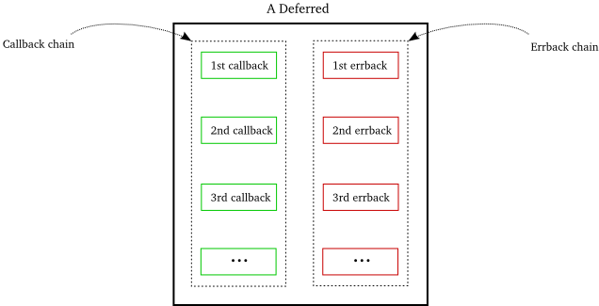
Deferred Callback / Errback Chain

Slide 16
Insult Server & Client
Code at: https://github.com/TransactCharlie/twisted-intro.git
Server is pretending to be a slow HTTP API that can take up to 5 seconds to return a random insult
Client makes 500 simultaneous connections and combines the results
Both use raw twisted using the provided twisted HTTP server / client objects

Slide 17
Spaghetti Code / Callback Hell
You can very, very easily write incredibly spaghetti code with twisted.
It can be very hard to understand what is happening in a twisted program
Especially if that program was written by someone else
Passing a deferred around effectively means you are returning a mystery pipe – at some point this pipe will have a value in it.
You should try very hard to make sure that value is defined up front!
Twisted provides some nice abstractions – you should make sure you use them rather than writing your own versions of these
Use Additional libraries – such as Klein / txRequests to make your life easier.

Slide 18
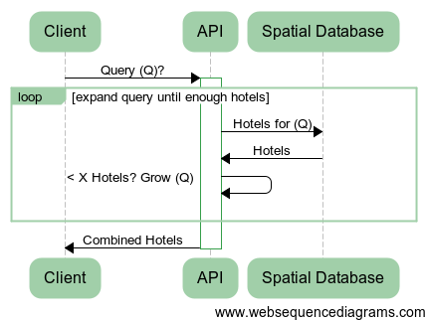
Twisted at Skyscanner
Query Expansion of Spatial Search

Slide 19
References
Original white paper on reactor pattern:
http://www.dre.vanderbilt.edu/~schmidt/PDF/reactor-siemens.pdf
Most awesome introduction to twisted I’ve ever found:
http://krondo.com/blog/?page_id=1327
Thanks to Dave Peticolas for the awesome help his blog was.
The maintainers of Twisted
http://twistedmatrix.com/trac/wiki/Documentation

